Slide 1

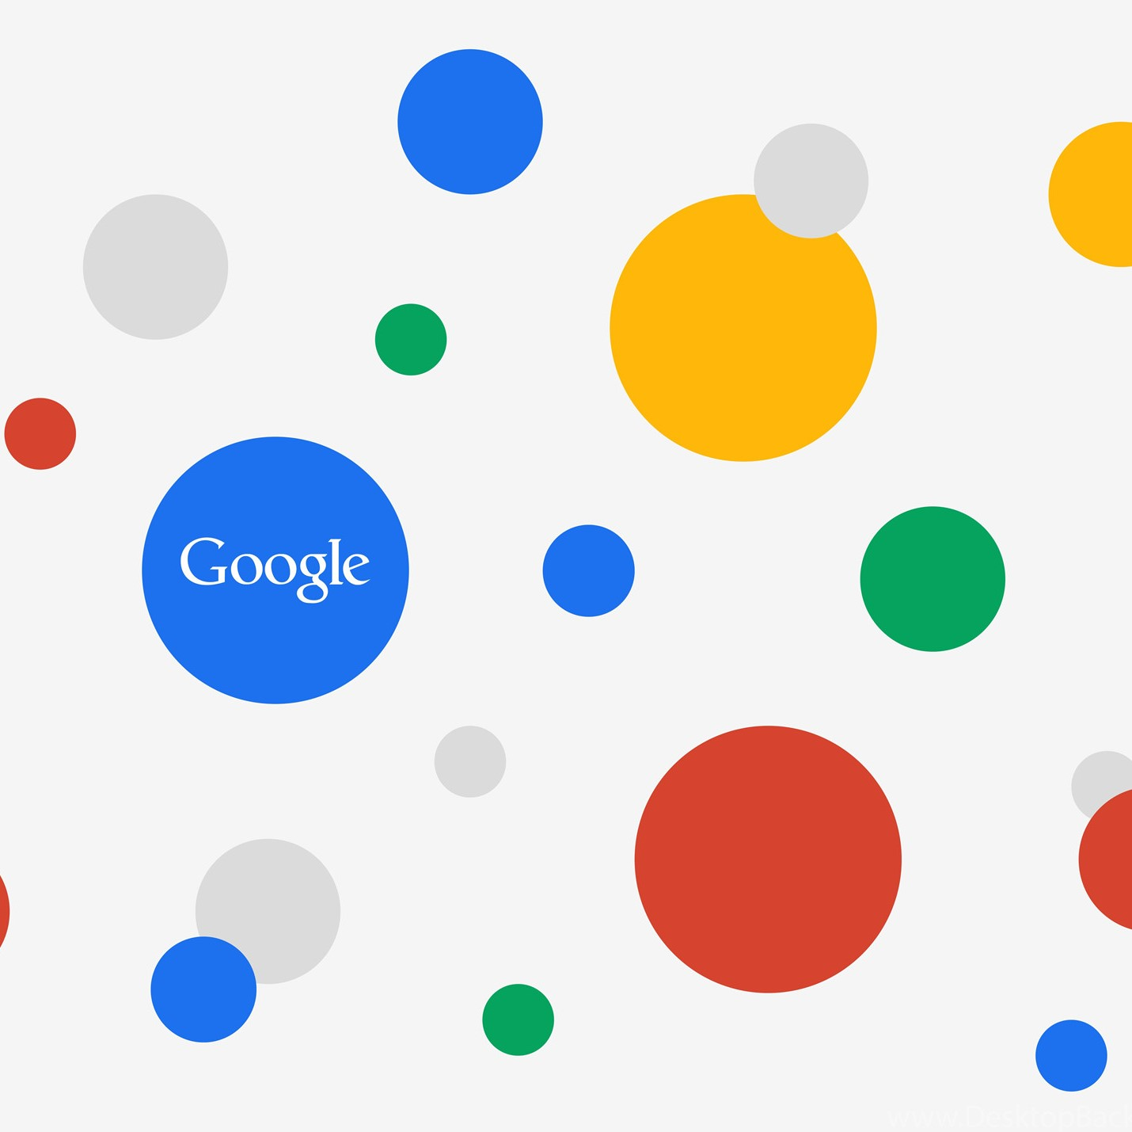
Picture : 4kwallpapers.com
Google trends for data analytics
Prepared by: Dhiar Niken Larasati
Jakarta, September 9th 2022

Slide 2

OUTLINE
1
WHAT IS GOOGLE TRENDS?
GOOGLE TRENDS IMPLEMENTATION IN DATA ANALYTICS
(SOME EXAMPLES)
2
HOW TO COLLECT AND ANALYZE GOOGLE TRENDS
(SOME PRACTICES)
3
Picture : pinterest.com

Slide 3
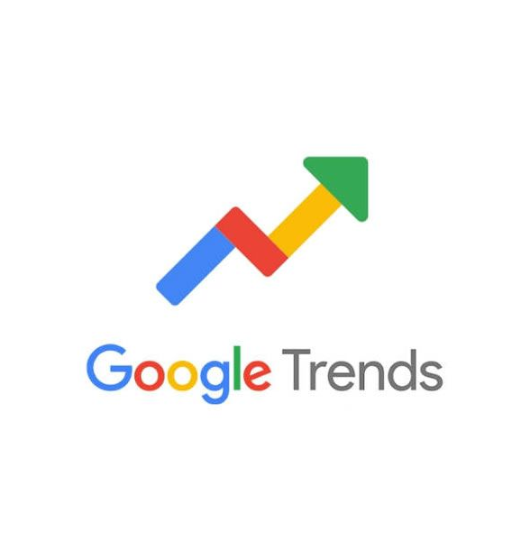
1
WHAT IS GOOGLE TRENDS?

Slide 4
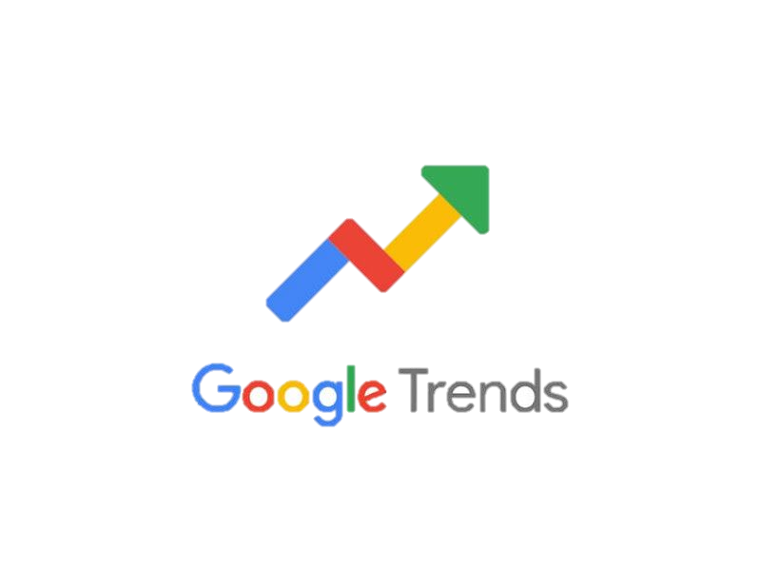
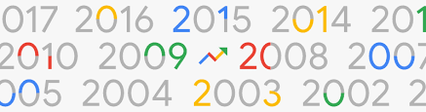
a feature from Google providing information concerning search requests made to the Google search engine
provides real-time and archived daily, weekly, and monthly data by geographic location and category (Mavragani, 2019; Varian,2009)

Slide 5
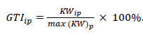

GOOGLE TRENDS CHARACTERISTICS
[JUDUL SLIDE SATU BARIS]
1
Real time and non real time
Real time : provide sample covering the last 7 days
Non real time : provide sample from 2004 and up to 36 hours before searching
Sample of search
2
Sample of billions of searches per day, focus on finding insights that can be processed within minutes of a happening event
Normalized data
3
To make comparisons between terms easier.
Numbers represent search interest relative to the highest point on the chart for the given region and time
Not polling data
4
Reflects the search interest in particular topics.
Should be compared with other data before drawing a conclusion
5
Can compare multiple search interests
Compares up to 5 search interests
Source : https://support.google.com/trends/

Slide 6
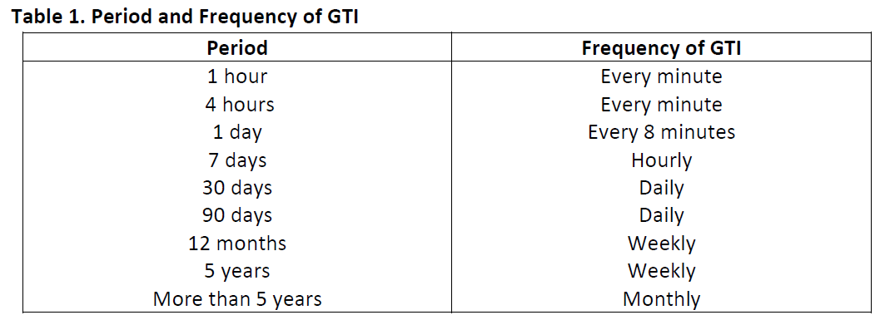
GOOGLE TRENDS CHARACTERISTICS
[JUDUL SLIDE SATU BARIS]
Source : https://support.google.com/trends/

Slide 7

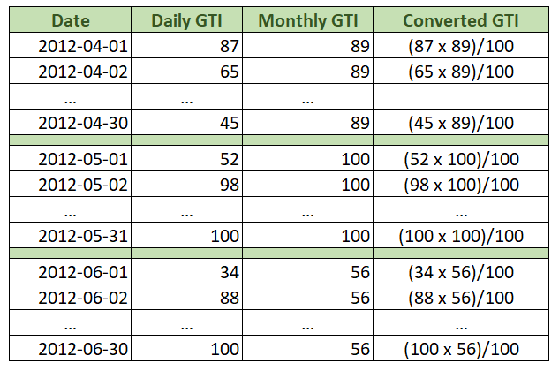
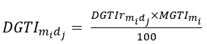
Disaggregating Monthly GTI to daily GTI
[JUDUL SLIDE SATU BARIS]
Retrieving monthly GTI
converting into comparable daily GTI over months
Retrieving monthly GTI from April 2012-June 2022
Retrieving daily GTI
Retrieving daily GTI separately for each month in the period April 2012-2022
Source: https://medium.com/@bewerunge.franz/google-trends-how-to-acquire-daily-data-for-broad-time-frames-b6c6dfe200e6

Slide 8
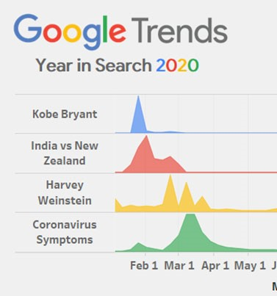
Picture : istockphoto.com
Picture : Roshaan Khan
2
GOOGLE TRENDS IMPLEMENTATION IN DATA ANALYTICS

Slide 9

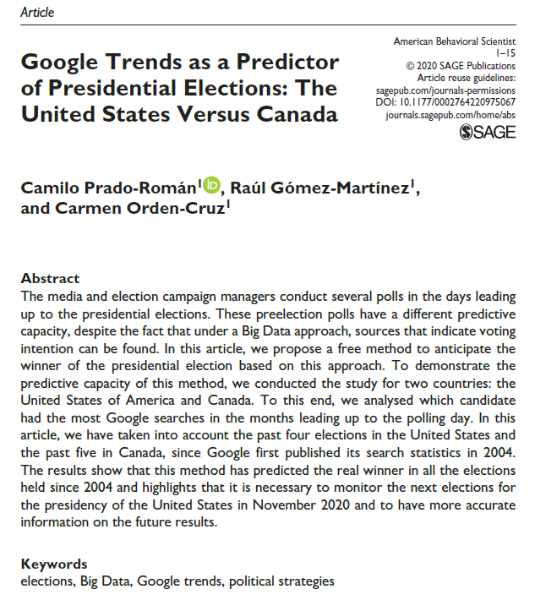
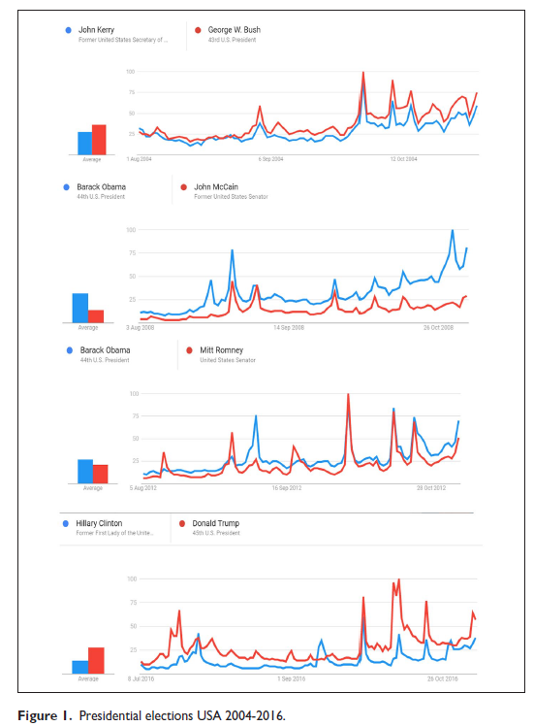
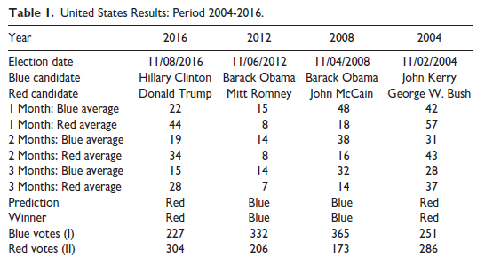
SOME EXAMPLES
[JUDUL SLIDE SATU BARIS]

Slide 10
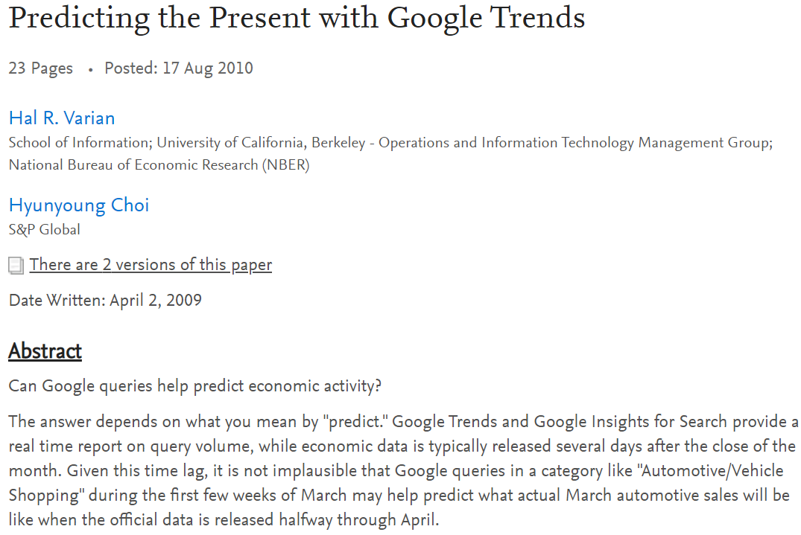
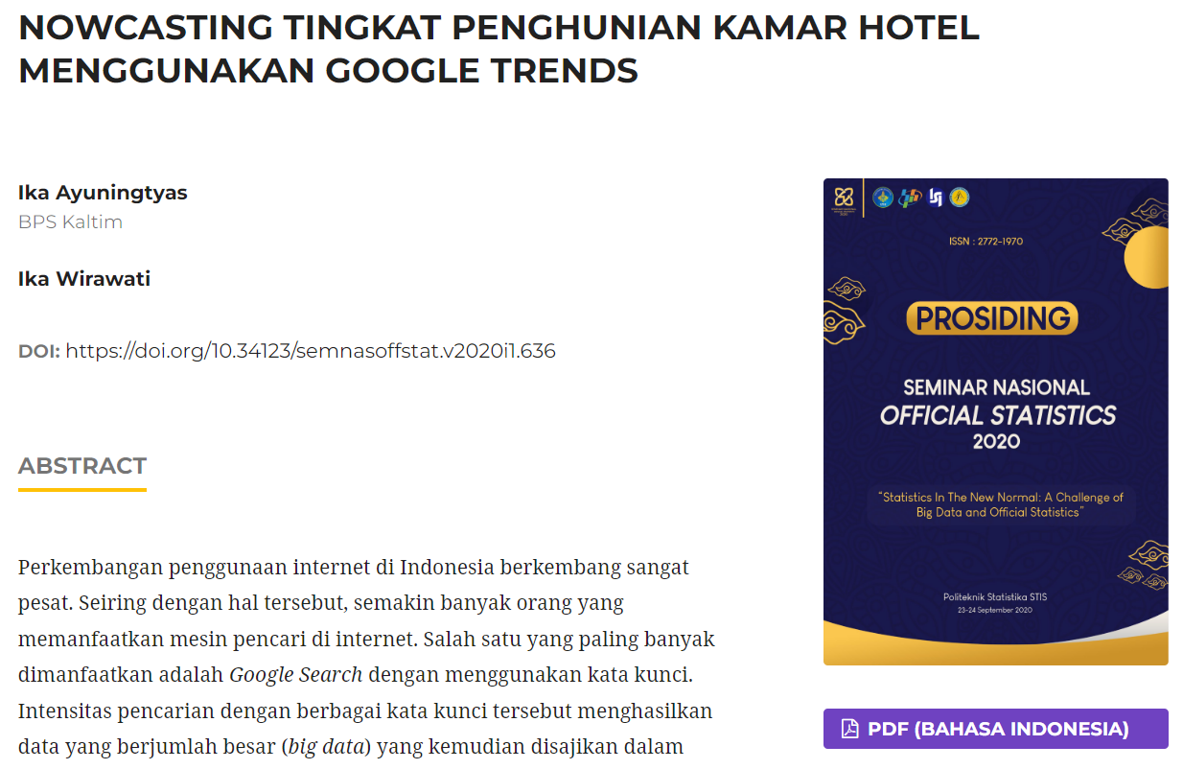
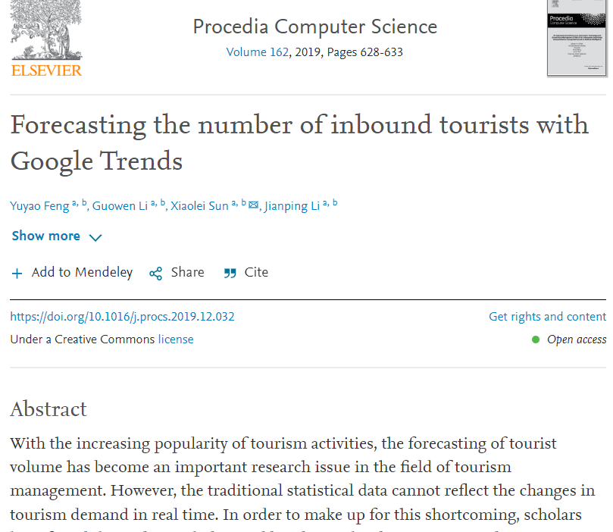
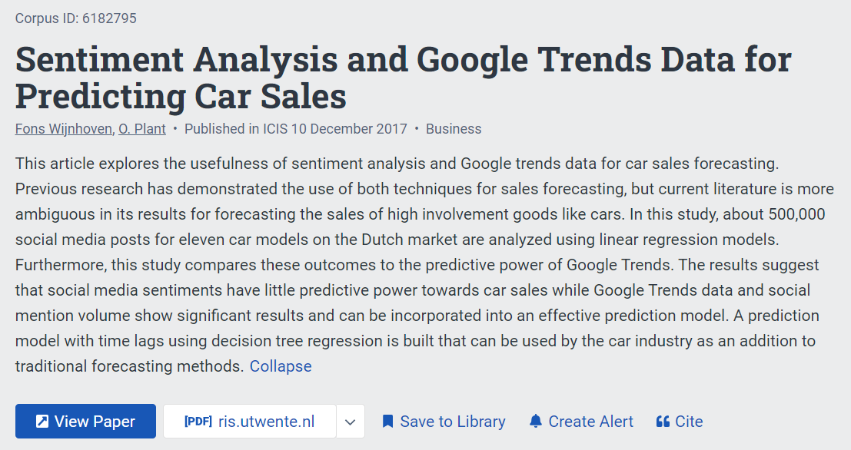
SOME EXAMPLES
[JUDUL SLIDE SATU BARIS]

Slide 11

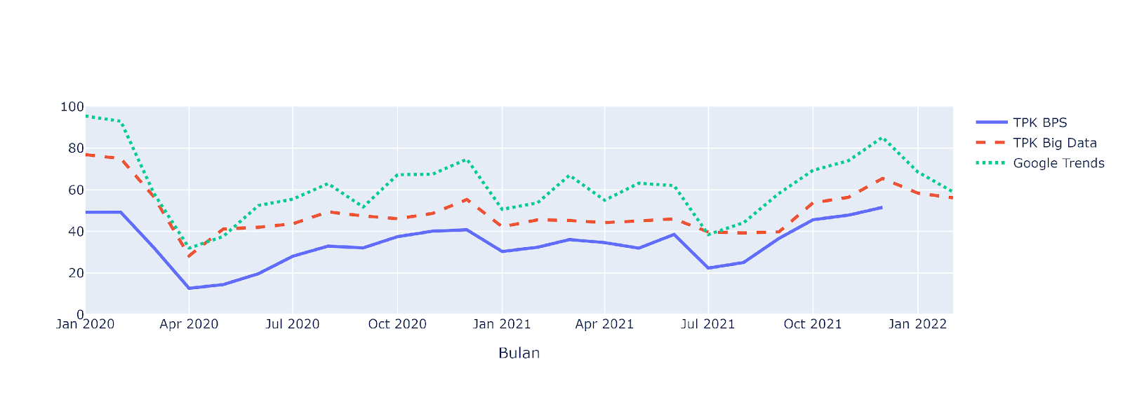
Google trends for validating official statistics and model prediction

Slide 12
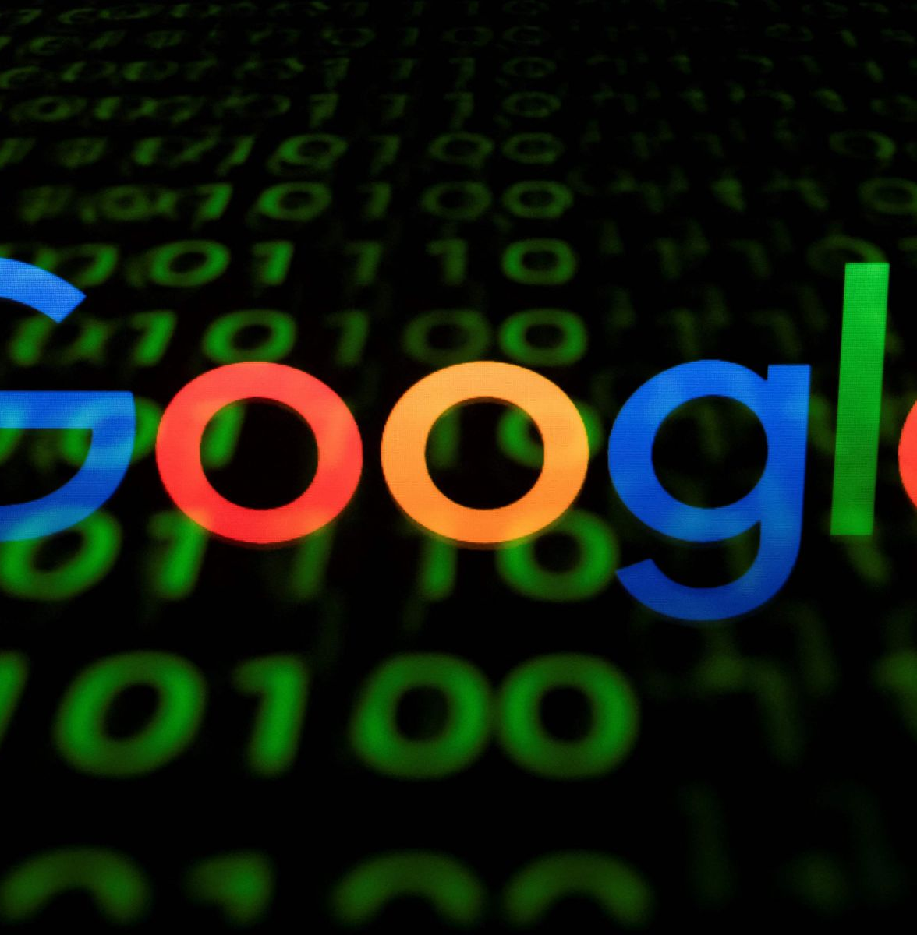
Picture : istockphoto.com
3
HOW TO COLLECT AND ANALYZE GOOGLE TRENDS

Slide 13
1
Download directly from google trends website
2
Run google trends queries in Python
(using Pytrends package)
GOOGLE TRENDS DATA COLLECTION
3
Run google trends queries in R
(using gtrendR package)

Slide 14
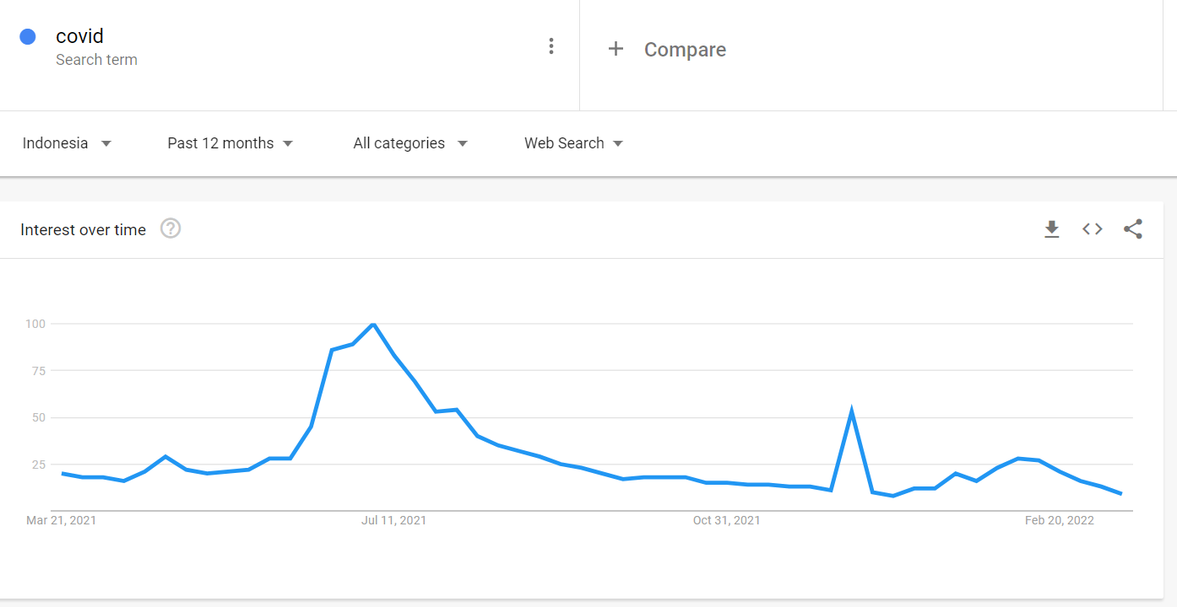
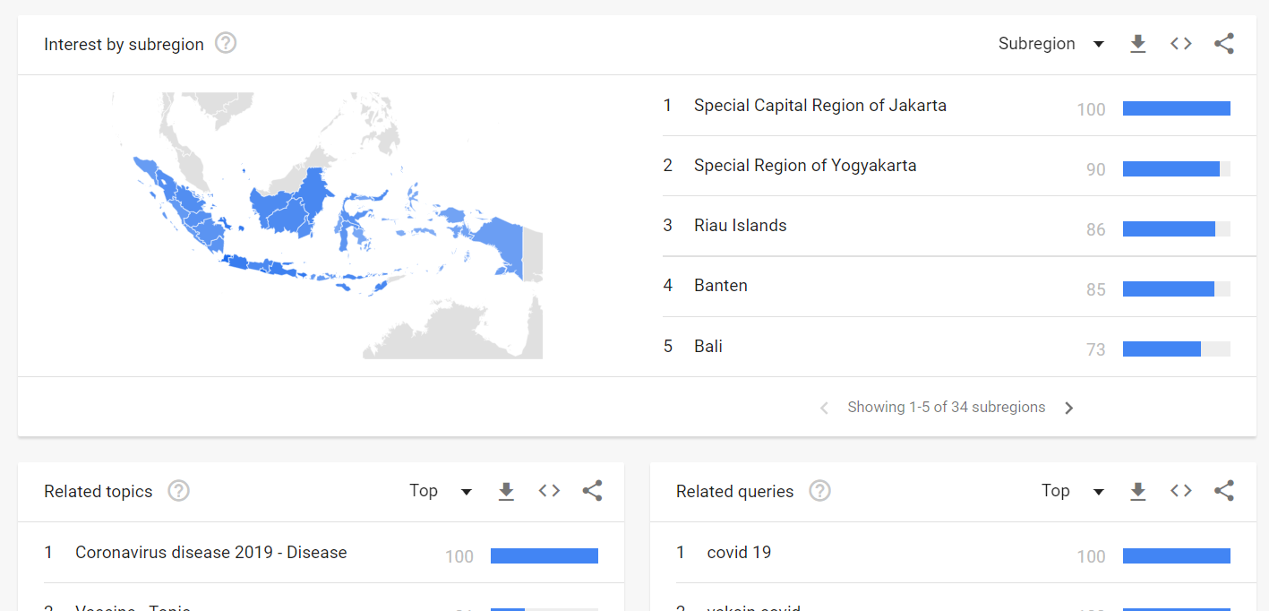
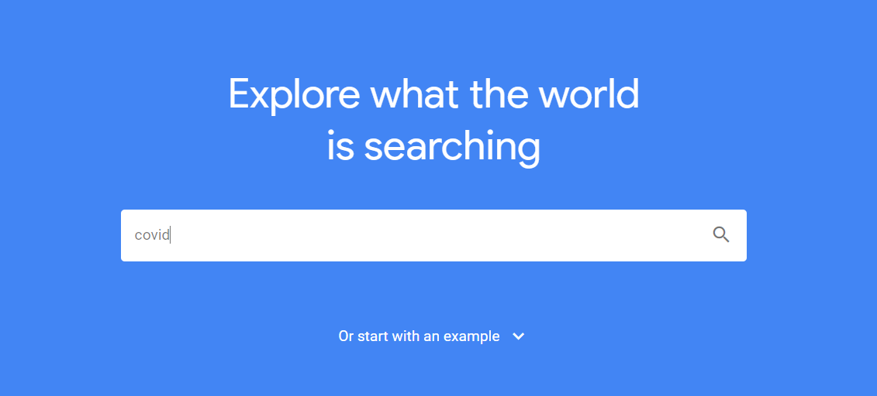
Download directly from google
trends website
[JUDUL SLIDE SATU BARIS]
3
4
2
1
Go to https://trends.google.co.id/
Enter a search term
Select region, period, categories which meet our research
Click download button on the top right
We can also download interest by region, related topics, and related queries as well
We’ll get .csv format data

Slide 15
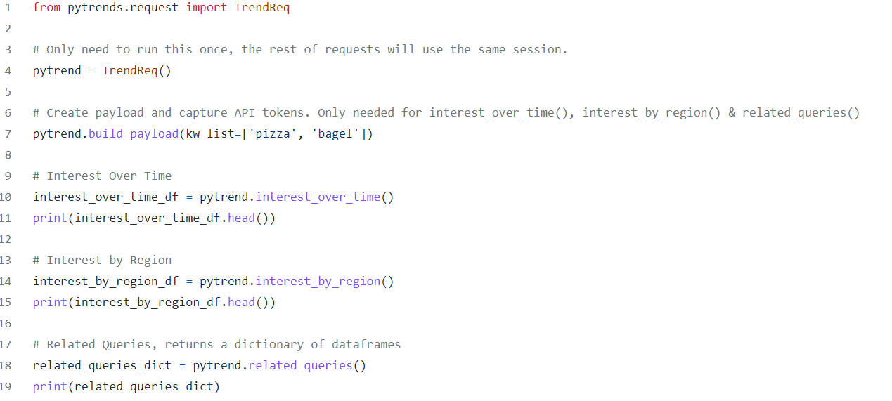
Run google trends queries in Python
(using Pytrends package)
[JUDUL SLIDE SATU BARIS]
Do pip install pytrends
Do some codes to get search interest over time, by region, or related queries
Go to https://github.com/GeneralMills/pytrends or https://pypi.org/project/pytrends/ to get more pytrends details

Slide 16
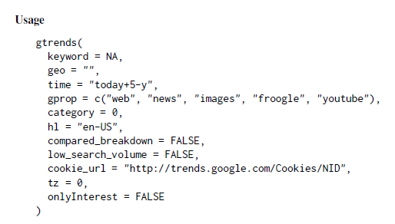
Run google trends queries in R
(using gtrendR package)
[JUDUL SLIDE SATU BARIS]
Do Install.packages(“gtrendsR”)
Do some codes to get search interest over time, by region, or related queries
Go to https://cran.r-project.org/web/packages/gtrendsR/gtrendsR.pdf to get more gtrendsR details

Slide 17
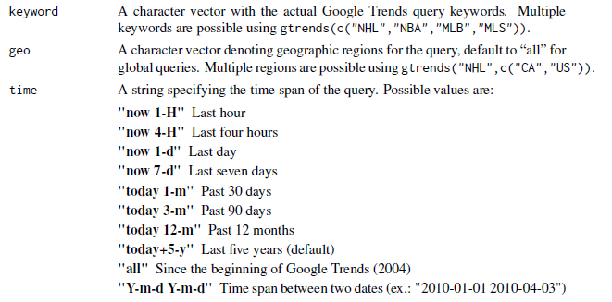
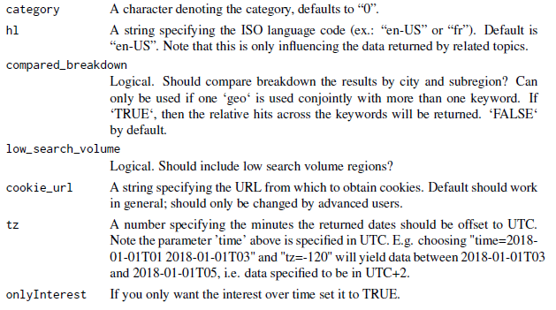
Run google trends queries in R
(using gtrendR package)
[JUDUL SLIDE SATU BARIS]
Some Arguments in gtrends function

Slide 18


Slide 19

Thank you!
Picture : 4kwallpapers.com

